Slide 1

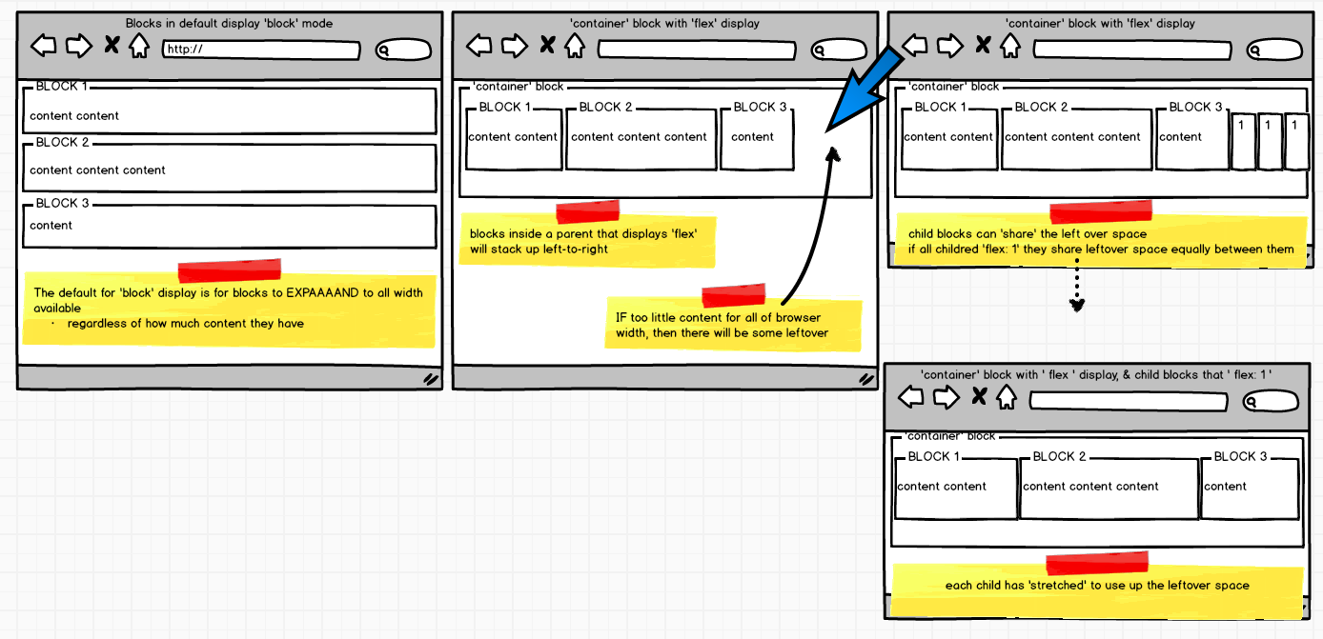
Web Development 1
© Hugh McCabe & Matt Smith 2008-2013
RECTANGLES RECTANGLES
RECTANGLES RECTANGLES
RECTANGLES RECTANGLES
(a.k.a. layouts with CSS Flexible boxes)

Slide 2
Sophisticated page layout control
In this week’s class we are going to learn how to:
  Style elements into columns/rows using ‘flexible’ boxes
We’ll learn to use versions of the following properties:
display: flex
flex: 1 / 1 0 200px
flex-wrap: wrap | nowrap | wrap-reverse
flex-direction: row / column
align-items: center;
For navbars, multi-column layouts, ‘gallery’ pages
  Straightforward & consistent approach to layouts

Slide 3
Flexible boxes are W3C ‘candidate recommendation’
the topics in this lecture are highly likely to become part of the next version of CSS
  But there is a small chance the odd term may change
  So (as with any part of computing) you need to keep up with web new standards as they are published
Sources of flexible box information:
w3c candidate recommendation (2012)
dev.w3.org/csswg/css-flexbox/
w3c EDITOR’S draft (2013)
dev.w3.org/csswg/css-flexbox/
CSS tricks website (2013)
css-tricks.com/snippets/css/a-guide-to-flexbox/

Slide 4
Wouldn’t it be nice if …
We could keep all the advantages of blocks
  Margins and padding all 4 sides
  They ‘fill’ available space
  E.g. so background is for block, not just letters or words
But we control whether blocks line up:
  Like a row (left to right)
  Like a column (top to bottom)
  Or a mixture for complex page layouts …
Flexible boxes allow us to CHANGE default layouts to allow control over page layouts …

Slide 5
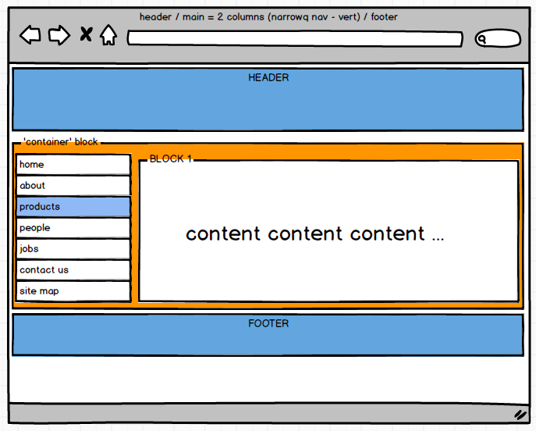
This kind of this will be EASY to create !

Slide 6
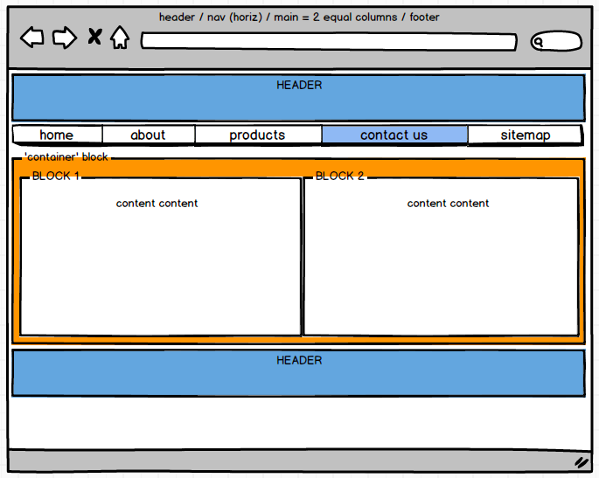
So will this …

Slide 7

Recap:
default block/inline layout

Slide 8
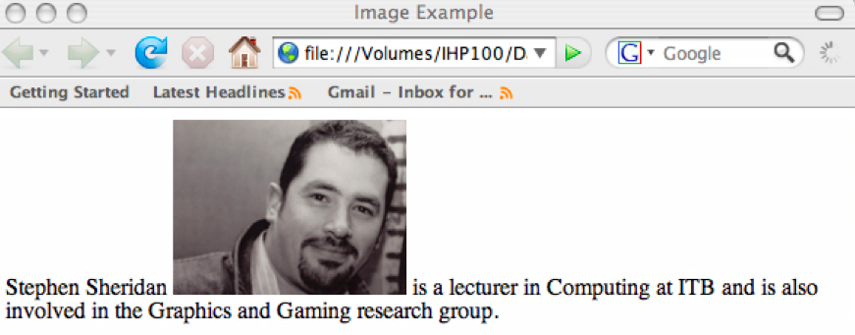
‘inline’ elements and their default layout
Letters and images are ‘inline’ elements
  They line up left-to-right
  And wrap onto next line when right side reached

Slide 9
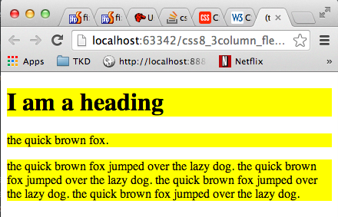
‘block’ elements and their default layout
Headings, paragraphs, list items etc. are ‘block’ elements
  Every block starts on a NEW LINE
  Blocks ‘expand’ to the full WIDTH available
    Even if little content in block …
So blocks stack top-to-bottom in browser window

Slide 10
Before we worry about the CODE
Understand the RECTANGLES …

Slide 11
KISS (Keep It Simple Silly …)
Make use of these DEFAULT layouts
  Don’t add CSS style or extra HTML DIVs etc. if not needed !
  So we’ll analyse rows then columns then rows etc.
i.e. most typical page layouts naturally have several self-contained horizontal blocks
  These fit within default block-level layout
  And may not need any special layout CSS …
EXAMPLE website:
  Maynooth Taekwon-do page …

Slide 12
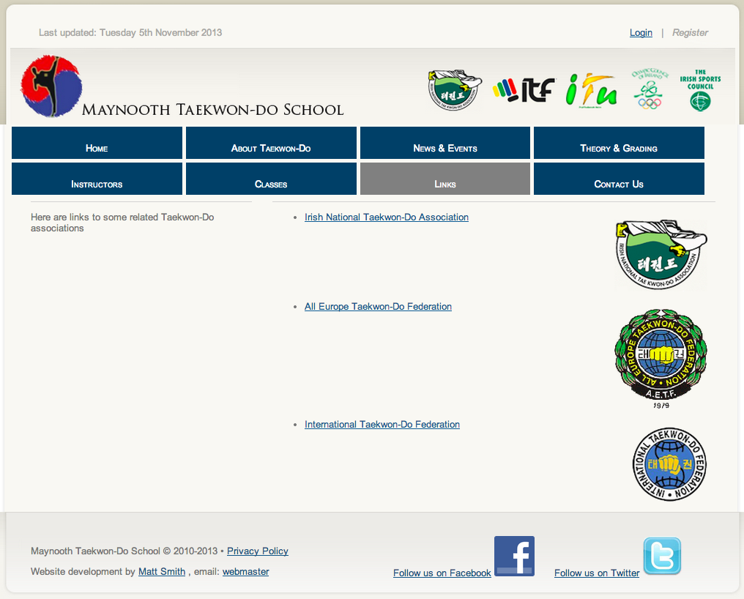

Slide 13
Step 1: divide into simple horizontal sections
each self-contained horizontal section should be a block
  See how many horizontal lines you can draw
  That run full width of page …
Usually we’ll have some / all of the following
  Header
  Nav
  Main
  Footer
  NOTE – there may be MORE THAN one of each …
Let’s do this for the Maynooth taekwon-do page …

Slide 14
header 1
header 2
nav
main
footer

Slide 15
We have now reduced complexity of our task …
we now have 4 or 5 small page sections to code
  Rather than the complexity of a whole page
We now have identified 5 horizontal blocks:
  header1
  header2
  nav
  main
  Footer
We’ll worry about each individually
  Although sometimes 2 or 3 can be coded together…

Slide 16

analyse each horizontal section in isolation
Step 2: analyse blocks in terms of vertical sections
(2a) header1 (and perhaps header2)
There may be several, equally good, alternative solutions, e.g. 2 likely approaches for header1 and header2
  Approach1:
    Have a single ‘header’ element, with 2 sections
  Approach2:
    Have two ‘header’ elements, with different classes
Matt’s approach:
  Look for similarity – if same approach can be taken for both, the code together, otherwise treat separately

Slide 17
Is there similar layout within each block??
Yes – both can be treated as split into 2 equal columns
  So we’ll treat these together, since can have same rules for each section of the header

Slide 18
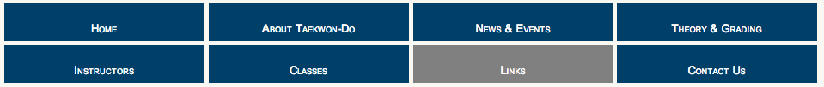
(2b) nav
Here we see 2 rows of 4 columns
We could treat this as 2 nav lists
  Row1: home / about / news / theory
  Row2: instructors / classes / links / contact
Or we could treat this as one nav block
  with wrapping when elements might be squashed smaller than a quarter width etc.
Choose whichever is most straightforward
  In this case I might go for a nav block, containing 2 lists of links (so there will always be 4 items per row)

Slide 19
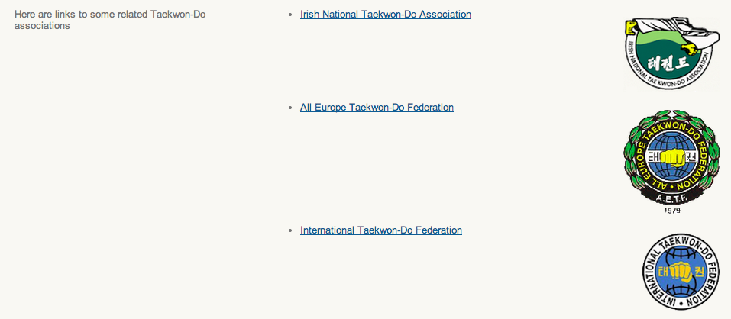
(2c) main
So 2 columns / vertical sections
Right hand section then split into 3 horizontal sections (rows)
  Each of these split into 2 columns

Slide 20
And so on …
So for each horizontal section
  If required, identify vertical sections within
  for each vertical section within, identify horizontal sections
  And so on …
A ‘recursive’, rectangle sub-division of page structure

Slide 21
Eg01
blocks_default_display

Slide 22
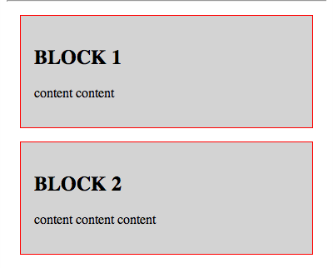
Each section has a bit of style (red border etc.)
So we can see its boundaries
<section>
<h2>BLOCK 1</h2>
<p>
content content
</p>
</section>
<section>
<h2>BLOCK 2</h2>
<p>
content content content
</p>
</section>
HTML

Slide 23
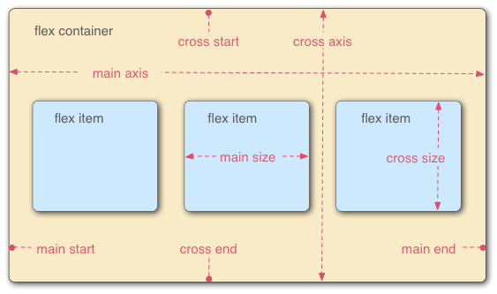
2 important core concepts:
Flex ‘container’ (parent block)
Flex ‘item’ (child blocks)

Slide 24
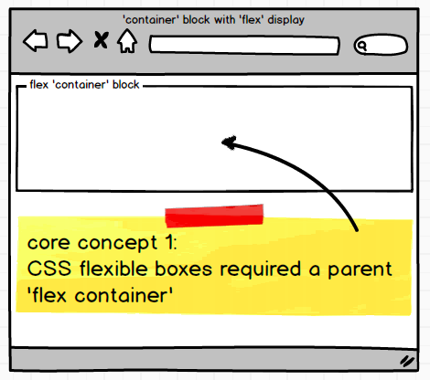
The flex ‘container’ block whose children can be arranged in rows or columns

Slide 25
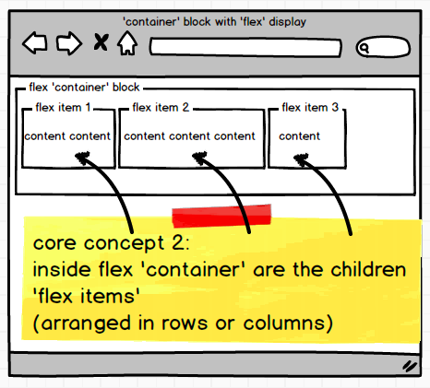
The flex ‘items’
- the children being laid out in the ‘container’

Slide 26
Eg02
blocks_in_flex_parent

Slide 27
We place the 2 SECTIONS inside a DIV parent given the ID = column_container
HTML
<div class="column_container">
  <section>
  <h2>BLOCK 1</h2>
  <p>
  content content
  </p>
  </section>
  <section>
  <h2>BLOCK 2</h2>
  <p>
  content content content
  </p>
  </section>
</div>

Slide 28
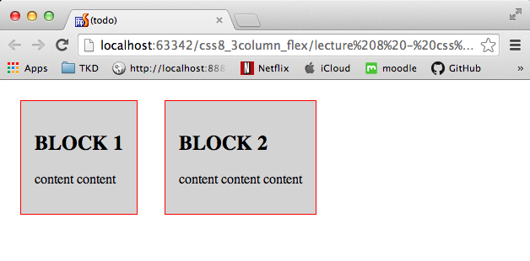
The DIV has been styled as a ‘flex container’
  display: flex;
  So the 2 SECTION children inside this DIV line up left-to-right (row layout is default for flex containers)
.column_container {
display: flex;
}
CSS

Slide 29
Note
  There is spare space on the right
  We can tell the children to ‘stretch’ to use up the spare space …

Slide 30
Eg03
blocks_stretch_no_wrap

Slide 31
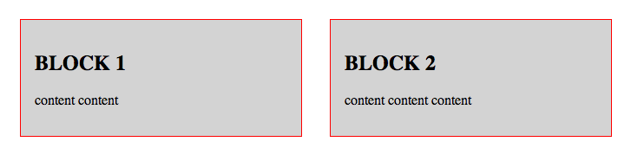
The HTML is unchanged
Each section has been styled to equally stretch with any spare width
  flex: 1;
  So the 2 SECTION children expand to be 2 equal columns
.column_container section {
flex: 1;
}
CSS

Slide 32
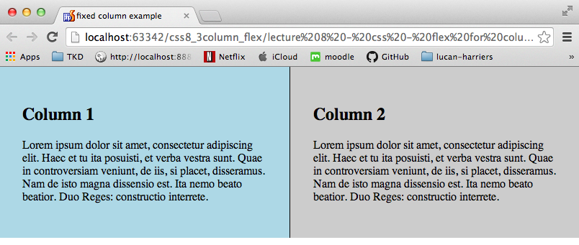
Here is same – but no margins on body or the sections – clean and simple 2 columns …

Slide 33
Eg04
one_fixed_one_flex

Slide 34
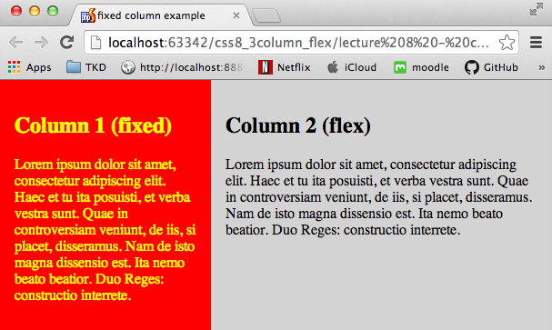
Left (red) column is FIXED width (width: 20rem)
Right (grey) column flexes (flex: 1)

Slide 35
Each section given a class
– so can be styled differently
<div class="column_container">
  <section class= "fixed">
  <h2>Column 1 (fixed)</h2>
  <p>
  content content
  </p>
  </section>
  <section class= "flex">
  <h2>Column 2 (flex)</h2>
  <p>
  content content content
  </p>
  </section>
</div>
HTML

Slide 36
Only one section class (right column) flexes
(so it takes up all the spare width …)
.column_container section.flex {
flex: 1;
background-color: lightgray;
padding: 1rem;
}
.column_container section.fixed {
width: 20rem;
background-color: red;
color: yellow;
padding: 1rem;
}
CSS

Slide 37
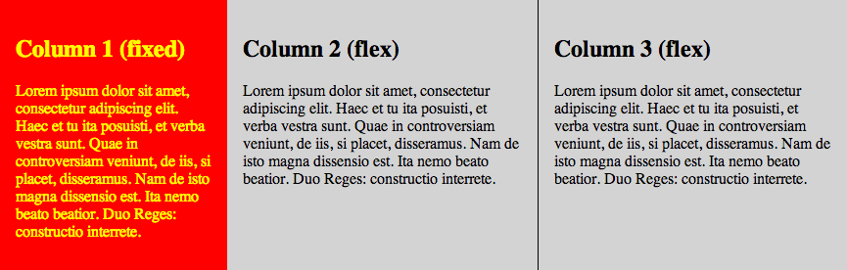
Add another flex column – no change to CSS

Slide 38
Eg05
blocks_in_flex_parent_
allowing_wrap

Slide 39
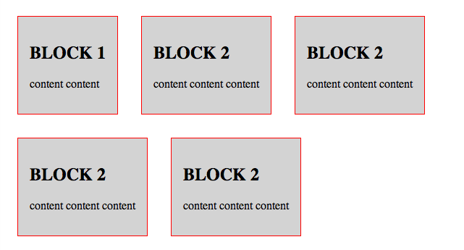
Style flex container (parent) to allowing wrapping

Slide 40
Required: style flex container to allow wrapping
Add code to flex container (parent) block, to allow wrapping
  .column_container {
  display: flex;
  flex-wrap: wrap;
  }

Slide 41
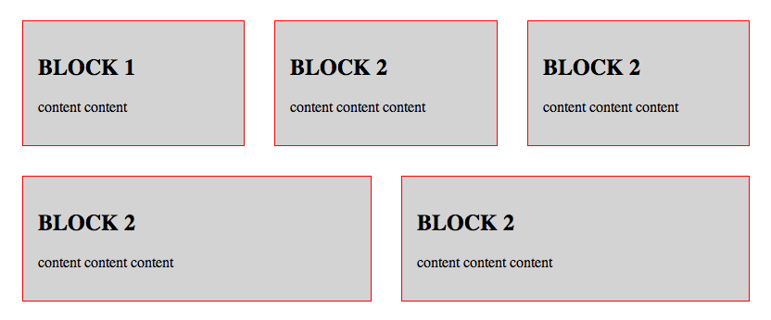
Usually desired: style flex items to stretch
(and then wrap when a min-width occurs)
Flex item (child) blocks to stretch: with third argument:
  Minimum width to trigger wrapping …
  .column_container section {
  flex: 1 0 20rem;
  }

Slide 42
Another handy uses of flexible boxes

Slide 43
Header/footer – left right alignment
Flexible container
2 flex items
Text align first one LEFT (default)
Text align second one RIGHT

Slide 44
Vertically align content in flex child

Slide 45
align-items: center
Give the flex container an align-items property
Can now easily vertically align content in flex items
.column_container {
display: flex;
align-items: center
}
CSS

Slide 46
Summary and Conclusions

Slide 47
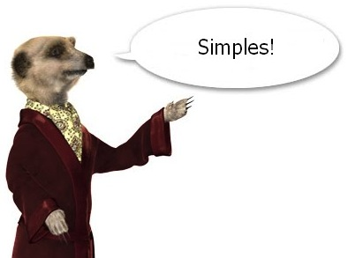
CSS flexible boxes
BLOCK level elements
  Basics are just 2 steps
(1) Flex ‘container’
  display: flex;
(2) Flex ‘items’ (children of container)
  In most cases wish to Make items equal width
  (and ‘stretch’ to fill available width of flex container)
  flex: 1;

Slide 48
Other issues wrap items
2 steps for wrapping blocks for narrow widths:
(1) for flex container add:
flex-wrap: wrap;
  (2) for flex item need to specify min-width to trigger wrap
  flex: 1 0 20rem;

Slide 49
Other issues coding care … target your CSS rules
AVOID ‘wildcard’ CSS rules
  p { … } affects EVERY p in the website
  section p { … } affects EVERY p in sections
    Sections in the header / nav / footer etc.
TARGET your rules according to the: Horizontal block
    header p { … }
    nav ul { … }
    .main section { … }
Even target a block on a particular page only:
  <body class="index"> <<< give body ID
  .index nav { ... } <<< target ‘nav’ on the ‘index’ page

Slide 50
Great CSS presenations by: zomigi.com
Zoe Mickley Gillenwater = ZO (e) MI (ckley) GI (llenwater)
If you want to get an idea of where CSS is going soon …
lots of up to date CSS - including flex box
  http://zomigi.com/events/blend-conference/
  http://www.slideshare.net/zomigi/the-future-of-css-layout
list of Zoe’s presentations:
  http://zomigi.com/speaking/
And not forgetting ‘smores day’ website demo of flex …
  http://smoresday.us/builder.html
Flex – change order of items
  http://css-tricks.com/using-flexbox/

